Slide 1
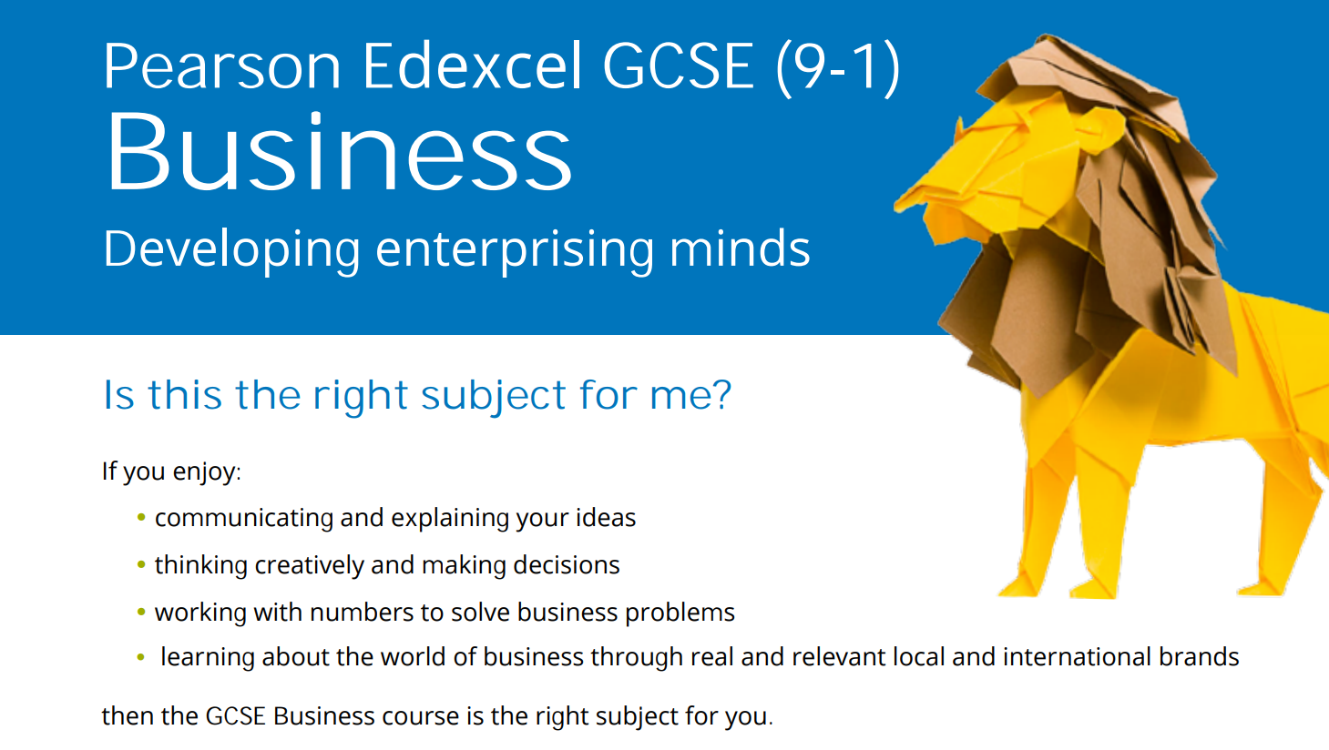

Slide 2
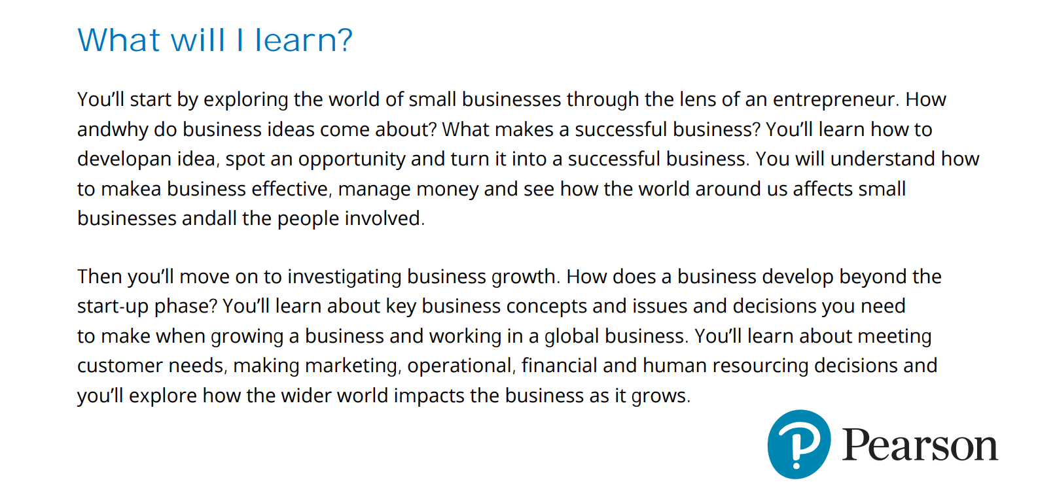

Slide 3
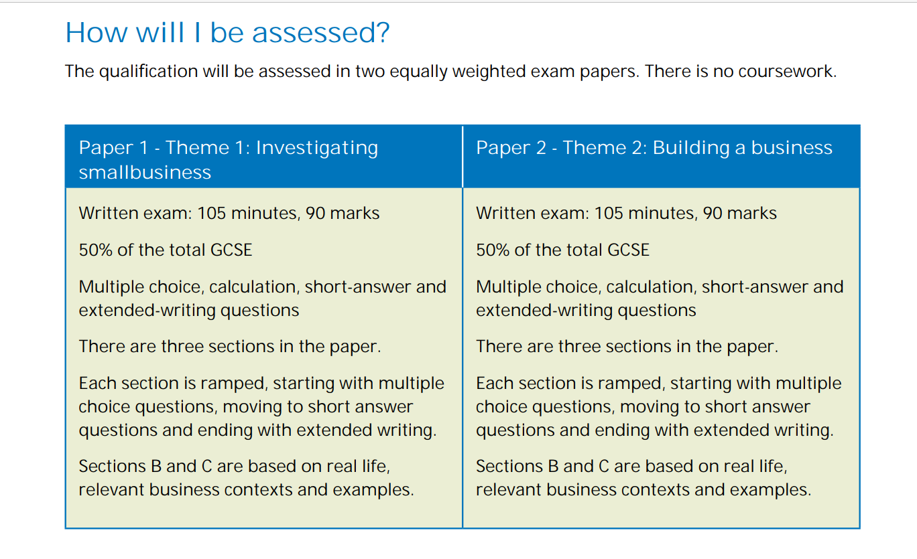

Slide 5
Enrichment
Future Leader Forum– small group interaction with business leaders “How has your business been affected by inflation”
Business Trips
Eunoia Speaker programme
Young Enterprise
Mini MBA

